Slide 1
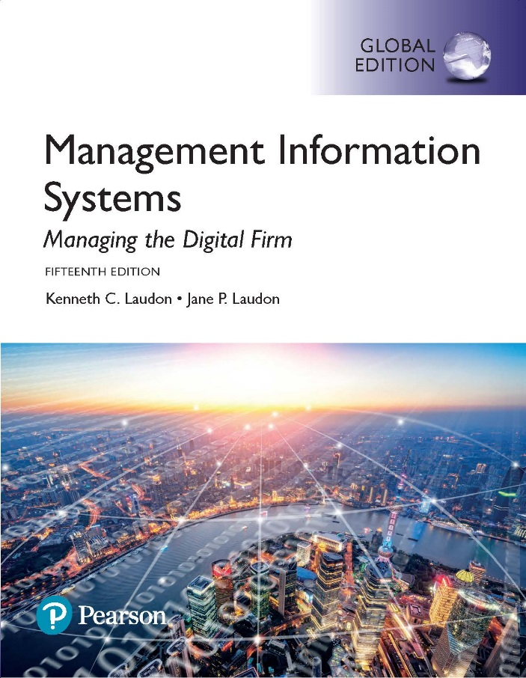
Management Information Systems: Managing the Digital Firm
Lecture 2
Fifteenth edition
Global E-business and Collaboration

Slide 2
Business Processes (1 of 2)
Business processes
  Flows of material, information, knowledge…
  Sets of activities, steps…
  May be tied to functional area or be cross-functional
Businesses: Can be seen as a collection of business processes
Business processes may be assets or weaknesses

Slide 3
Business Processes (2 of 2)
Examples of Functional Business Processes
Manufacturing and Production: Product assembly
Sales and Marketing: Customer identification
Finance and Accounting: Preparation of financial statements
Human Resources: Employee recruitment
Notes:
Other examples include checking the product for quality (manufacturing and production), selling the product (sales and marketing), paying creditors (finance and accounting), and evaluating job performance (human resources). You could ask students to contribute other examples of business processes and describe which of the four types they are.

Slide 4
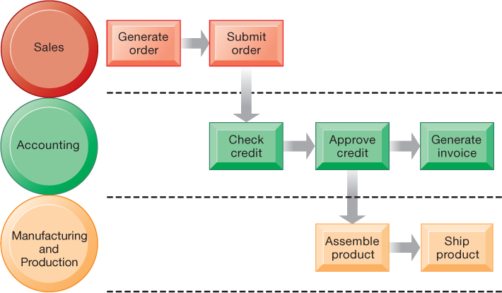
Order execution process
Notes:
Figure 2.1, Page 45.
Fulfilling a customer order involves a complex set of steps that requires the close coordination of the sales, accounting, and manufacturing functions.
Emphasize that each rectangle represents one part of the larger business process of order fulfillment. Notice that this business process spans several different functional areas of the business from sales (orders), to accounting, to manufacturing. Important business processes typically span several different functional areas or divisions in a business.
: A diagram depicts the steps on three different levels that are involved in an order fulfillment process. The first level is labeled, Sales, and the following items are listed. Generate order, Submit order. The next level is labeled, Accounting, and the following items are listed. Check credit, Approve credit, Generate invoice. From the, Approve credit, step of, Accounting, the process also proceeds to the Manufacturing and Production level, under which the following items are listed. Assemble product, Ship product.

Slide 5
How IT Improves Business Processes
Increasing efficiency of existing processes
  Automating tasks that were hand-operated
Enabling entirely new processes
  Changing flow of information
  Replacing sequential steps with simultaneous steps
  Eliminating delays in decision making
  Supporting new business models
Notes:
Examples of entirely new business processes made possible by information technology are downloading a song from iTunes or buying a book or e-book from Amazon. You might also mention the Amazon book reader Kindle which is continuously connected to the Internet and allows customers to download books and pay for them using Amazon’s one-click purchase method. Ask students if they can name any other business processes that have been transformed in the last year years.

Slide 6
Systems for Different Management Groups (1 of 2)
Transaction Processing System (TPS)
Supports operational managers and staff
Handles and records routine daily transactions essential for business operations
Examples include sales order entry, payroll processing, and shipping activities
Focuses on predefined, structured objectives and decision-making processes
Notes:
The purpose of these systems is to answer routine questions about the flow of transactions through the organization. These systems are a necessity for any business.

Slide 7
Systems for Different Management Groups (2 of 2)
Management Information Systems
Support middle management in supervising operations.
Generate reports on the company’s current performance using data collected from TPS.
Respond to routine questions through predefined procedures.
Notes:
This slide emphasizes the relationship between the class of software called “business intelligence” and the decision support systems used by middle and senior management, DSS and ESS. Business intelligence is a type of software used in analyzing data.

Slide 8
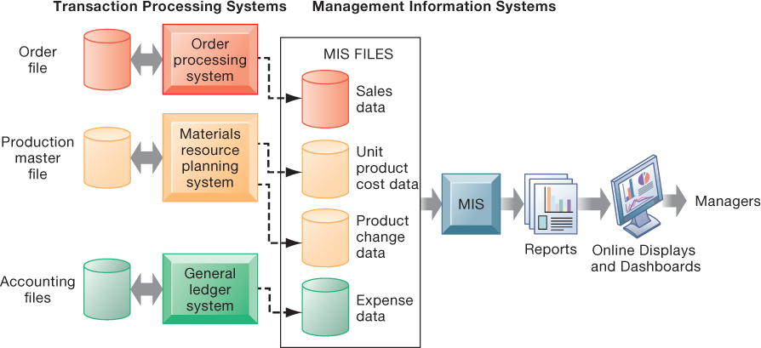
How MISs obtain their data from the organization’s TPS
Notes:
The General Ledger System (GLS) is the core accounting system of an organization.
النظام المحاسبي الأساسي

Slide 9
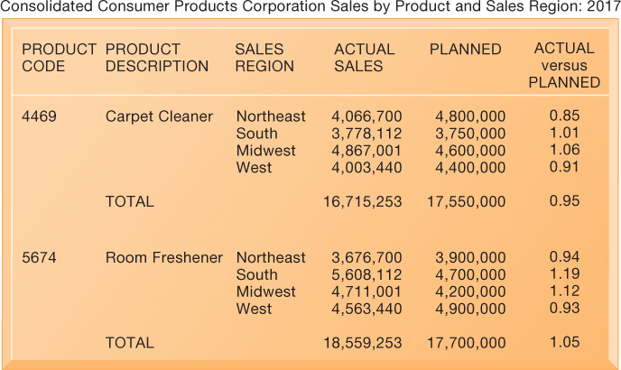
Sample MIS Report
Notes:
Figure 2.4, Page 49.
This report, showing summarized annual sales data, was produced by the MIS in Figure 2.3.
This graphic represents the “reports” portion of the Figure 2-3. Emphasize this to students, perhaps referencing that slide again to drive home that point. Students may not understand the decimals in the “ACTUAL versus PLANNED” category, where anything above 1.00 represents more sales than planned and anything less represents a disappointing result of fewer sales than planned.

Slide 10
Decision support systems
Assist middle management in handling complex or nonroutine decisions.
Analyze scenarios such as: What would happen to the production schedule if December sales were to double?
Incorporate both internal data (from TPS/MIS) and external information when needed.
Notes:
You could ask whether or not students understand what is meant by nonroutine decision making, as opposed to routine decision making, and why DSS are specifically designed to assist managers in making that type of decision. Ask students for examples of nonroutine decisions they make or have made in the past as managers or employees.

Slide 11
Executive Support Systems
Assist senior management in making nonroutine decisions
Decisions that require judgment, evaluation, and insight
Use data on external events along with summarized information from MIS and DSS
Example: Digital dashboards providing a real-time overview of the company’s financial performance

Slide 12
A digital dashboard delivers comprehensive and exact information for decision making often using a single screen.
The graphical overview of key performance indicators (KPIs) helps managers quickly spot areas that need attention.

